Slide 1

Graphing with matplotlib
ENGR 96A: Python and Machine Learning

Slide 2
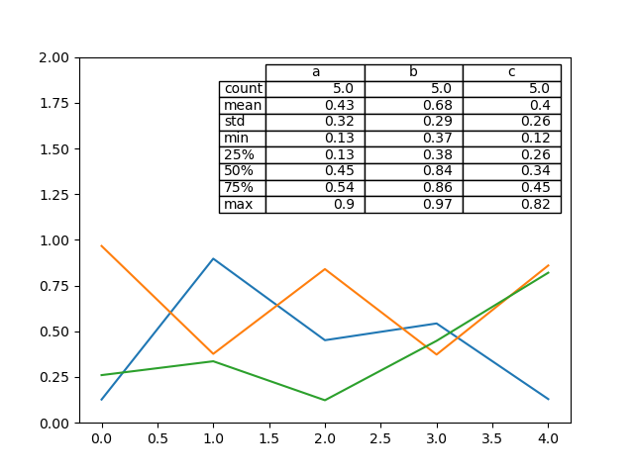
Why is Plotting important?
The Matplotlib library in python is a powerful data analysis tool that can be used to visualize data
Which is more intuitive - table or graph?

Slide 3
Getting started
We will make use of the matplotlib.pyplot library
import matplotlib.pyplot as plt
This is like importing any other library
Like numpy, we import it as something else to make calling functions easier
import matplotlib.pyplot as plt

Slide 4
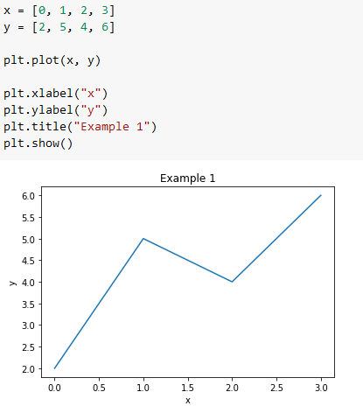
Making a basic graph
Essential components:
X and Y points
plt.plot(x, y)
plt.show() to display the plot
Also very important for clarity
plt.xlabel()
plt.ylabel()
plt.title()

Slide 5
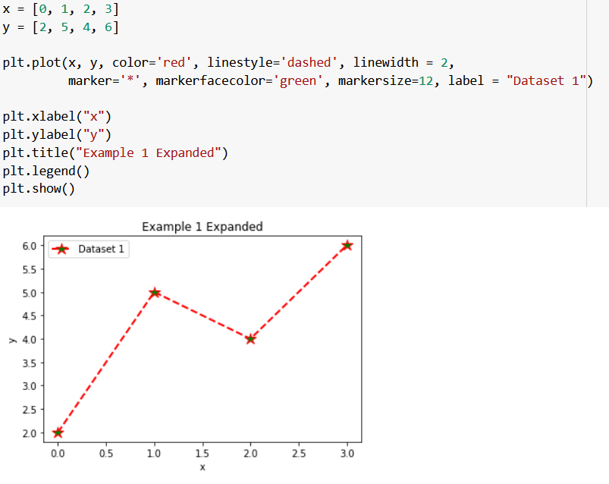
Customizing Graphs
Many ways to customize graph output in plt.plot() function
Color = change line color
Linestyle -change line style
Linewidth - change line width
Marker - change point marker
Markerfacecolor - change marker color
Markersize - change maker size
Label - label for legend
Just add the after x,y
Additionally, to add a legend, be sure to add plt.legend() to your code
Helpful when graphing multiple functions!

Slide 6
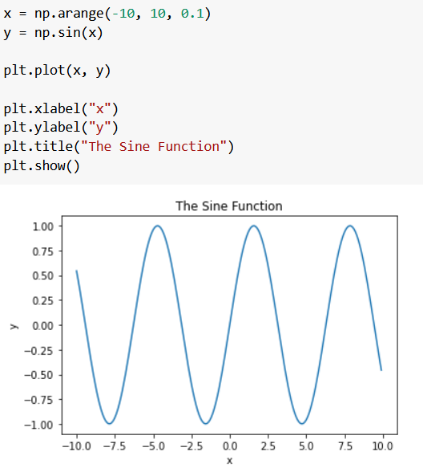
Graphing a function
Use np.arange(start, stop, step) to create x
y = f(x)
Label your graphs!

Slide 7
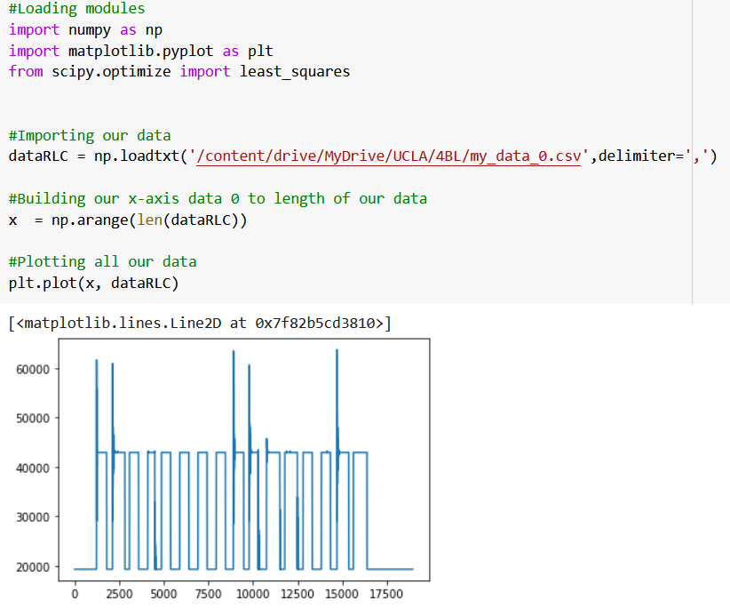
Graphing outside data
You can import outside data using numpy and use its splicing functions to get x and y for matplotlib analysis!
Note: Delimiter is what separates data points with the imported file, comma for .csv files

Slide 8
Happy graphing!

